Slide 1
MIPS Simulator
Sam D, Tim S, Moji A, Patricio F
Notes:
MOJI

Slide 2
Our Design Strategy
We wrote our code in C++
We decided to imitate the hardware directly
Notes:
MOJI

Slide 3
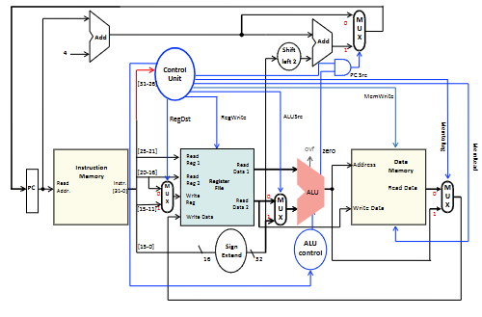
Each component in the datapath became a distinct module.
For example, we have a separate classes for the control unit, MUX, ALU, Register File and so on.
Notes:
MOJI

Slide 4
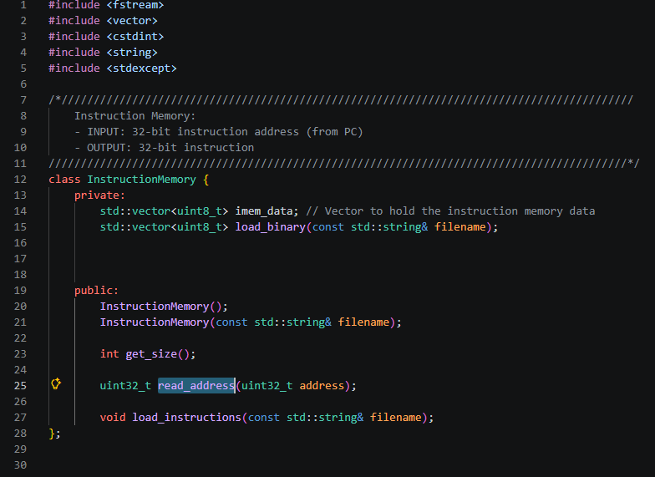
Instruction Memory
Notes:
SAM

Slide 5
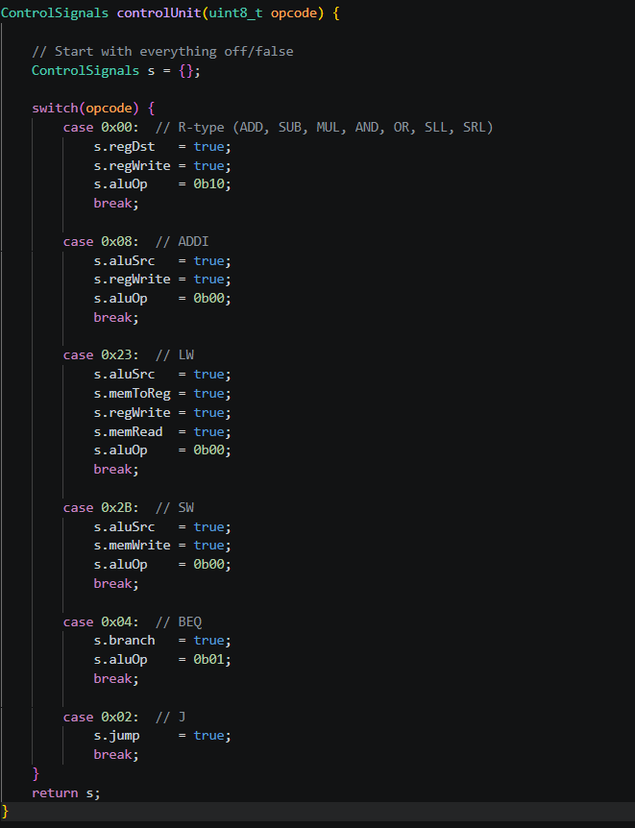
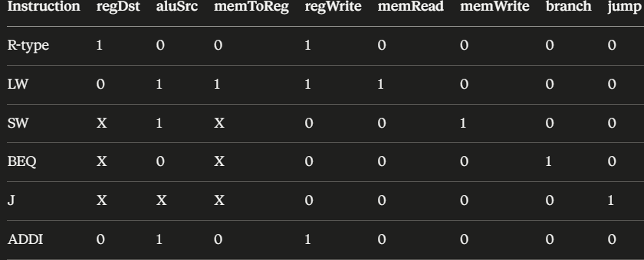
Control Unit
Reads opcode (bits 31-26) and outputs control signals.
Each signal then tells a specific component what to do.
Notes:
MOJI

Slide 6
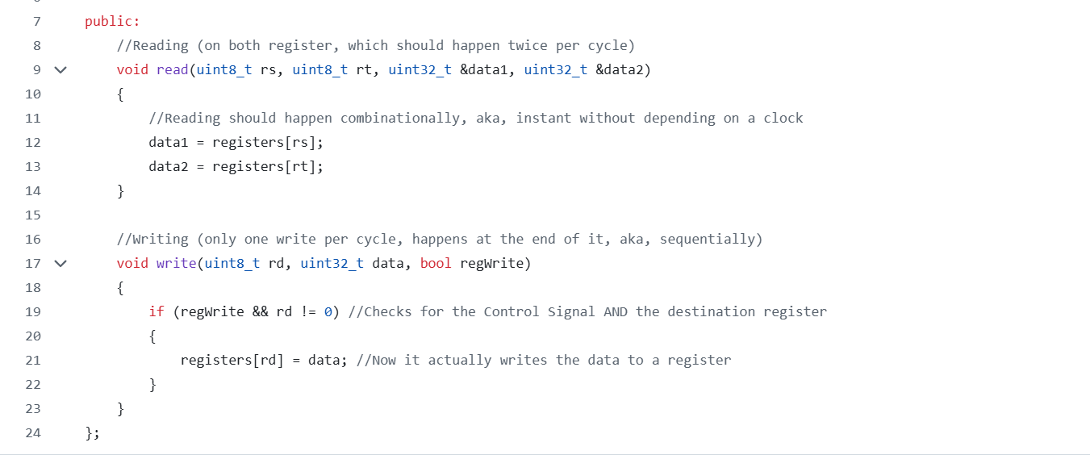
Register File
Makes 32 registers all initialized to 0.
Reads twice per cycle asynchronously.
Writes at the end of cycle sequentially
Notes:
PATRICIO

Slide 7
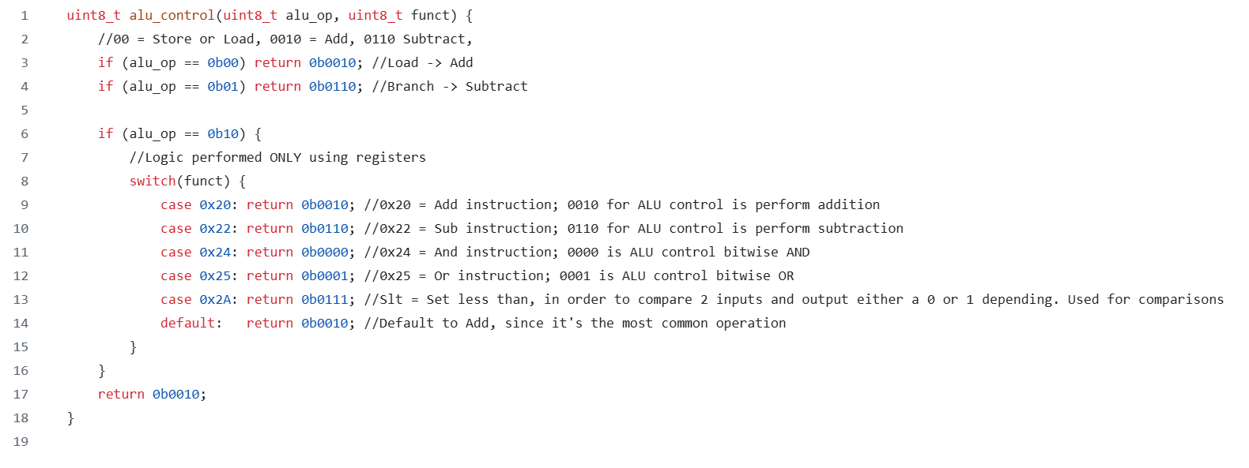
ALU & ALU CONTROL
ALU control takes the opcode and the instruction details to output a 4-bit command to the ALU
The ALU chooses an operation depending on the 4-bit command and performs it with it’s 32-bit inputs, outputting a 32-bit.
Notes:
PATRICIO

Slide 8
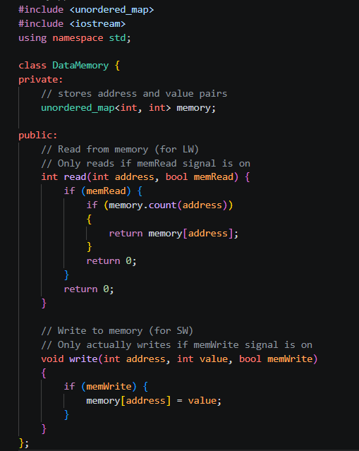
As we know, this is where values are stored during program execution.
Only LW and SW ever touch it. so memRead and memWrite control signal gate all access.
An unordered_map was used because it only stores addresses that are actually written.
Data Memory
Notes:
MOJI

Slide 9

Instruction Cycle
All 5 stages of the pipeline are inside a while loop in the main function that runs as long as there are still instructions that remain.

Slide 10
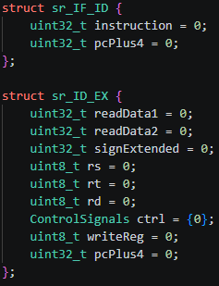
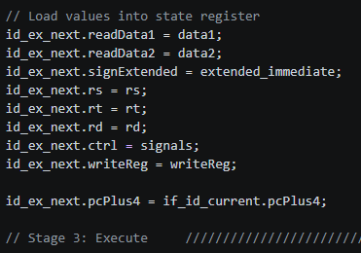
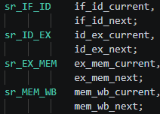
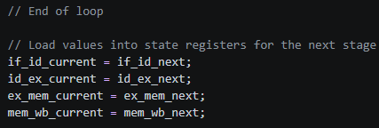
Pipeline
We used structs to represent the state registers. Each state register has a ‘current’ version (where data is read from) and a ‘next’ version (where data is written to).
Notes:
MOJI

Slide 11
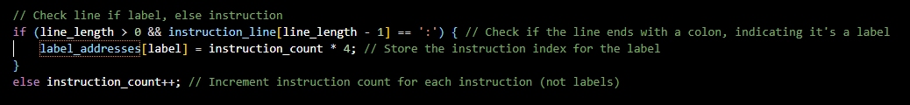
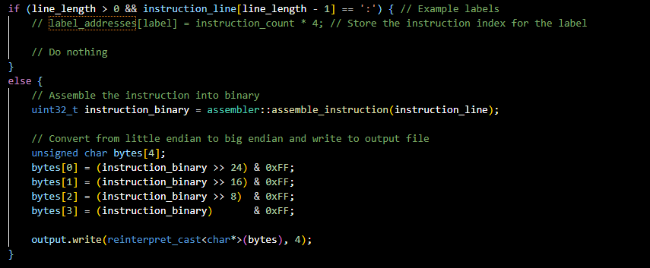
Assembler: 2-Pass Instruction Read
Notes:
SAM

Slide 12
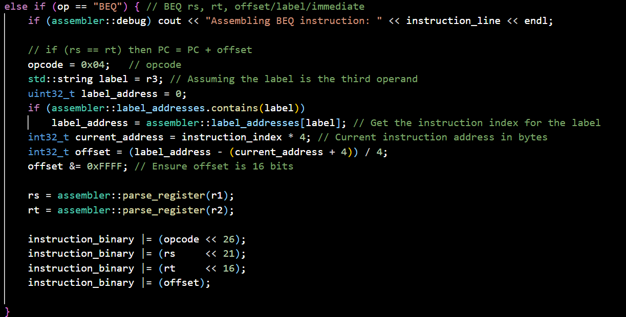
Assembler: Encoding Example - BEQ
Notes:
SAM

Slide 13
Planned Revisions
Create Data Memory Output
Organize our debugging mode
Organize our Directory
Notes:
SAM

Slide 14
DEMO
Notes:
MOJI

Slide 15
THANK YOU!!!
Any Questions?

